Slide 1

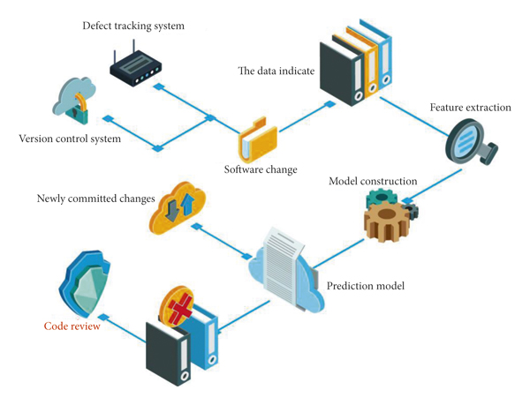
"SMOTEEN based Boosting method: Optimal Sampling Strategies for Imbalanced Software Defect Classification"
Software Engineering Department
Prof. Duksan Ryu
Electronics and Information Engineering
Sadik Bhattarai
NSCL LAB

Slide 2
Contents
Introduction
Background (optional)
Related Work
Proposed Method
Experimental Setup
Experimental Result
Discussion (optional)
Conclusion
Future Work (optional)

Slide 3
Introduction
Classification is an important task in data mining and knowledge discovery. - Imbalanced class distribution is a serious difficulty for most classifier learning algorithms.
Imbalanced data sets have many more instances of some classes than others.
The imbalanced problem is particularly challenging for bi-class applications.
The skewed data distribution is not the only parameter that influences the modelling of a capable classifier in identifying rare events.
Other influential factors include small sample size, separability, and the existence of within-class sub-concepts.
To deal with the class imbalance problem, one common strategy is to choose an appropriate inductive bias.
Algorithm-level approaches include adjusting probabilistic estimates, developing new pruning techniques, using different penalty constants, and adjusting the class boundary based on kernel-alignment ideal.
To develop an algorithmic solution, one needs knowledge of both the corresponding classifier learning algorithm and the application domain.

Slide 4
Related Work
Weiss and Provost showed that the performance of several popular classification algorithms, including decision trees and neural networks, degrades significantly when the class distribution is imbalanced.
Chawla et al. proposed a synthetic oversampling technique to balance the class distribution and improve the performance of classification algorithms.
Drummond and Holte proposed a cost-sensitive decision tree algorithm that adjusts the misclassification costs of different classes to handle class imbalance.

Slide 5
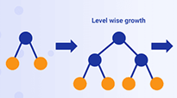
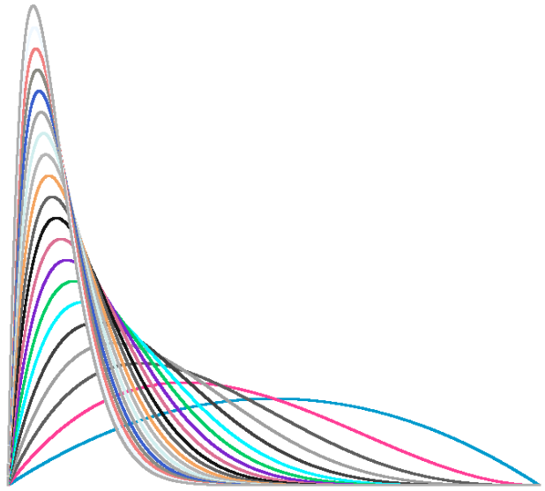
Proposed Method
Proposed Algorithm to handle imbalance dataset
SMOTEEN
(SMOTE + NN)
MCC
G-MEAN
ROC-AUC
JM1 Dataset
(Imbalance dataset)
SMOTEEN driven LGBM approach
Data Preprocessing
K-fold train dataset
LGBM
Visualization
Test data
SMOTEEN + LGBM Optimal model
Structured Dataset
Optimal Model
RAW Dataset
Metrics
Figure : Architecture for SMOTEEN BASED (under sampling + oversampling) using LGBM boosting method for improved classification in JM1 dataset.

Slide 6
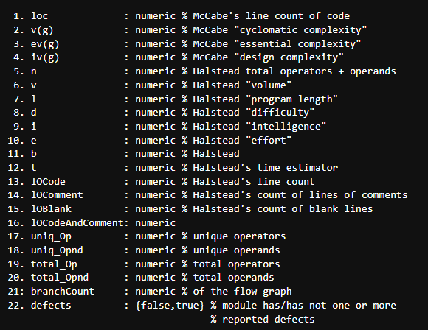
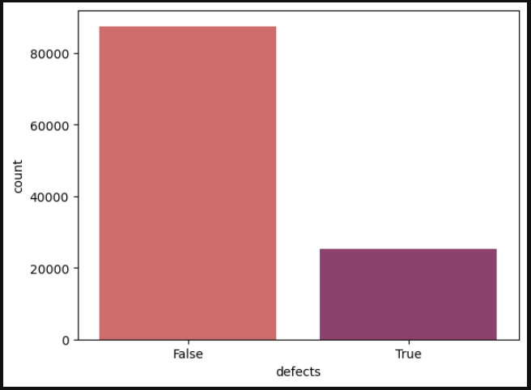
Experimental Setup
Dataset : Obtained from Promise dataset repository.
Details instance are present in figure.

Slide 7
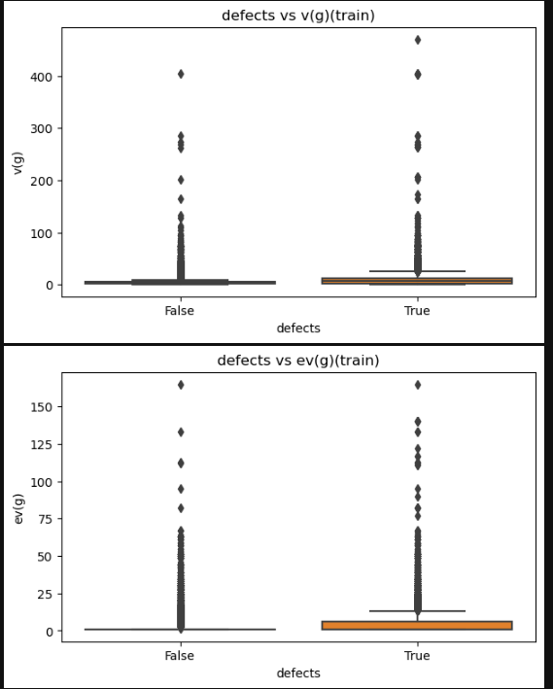
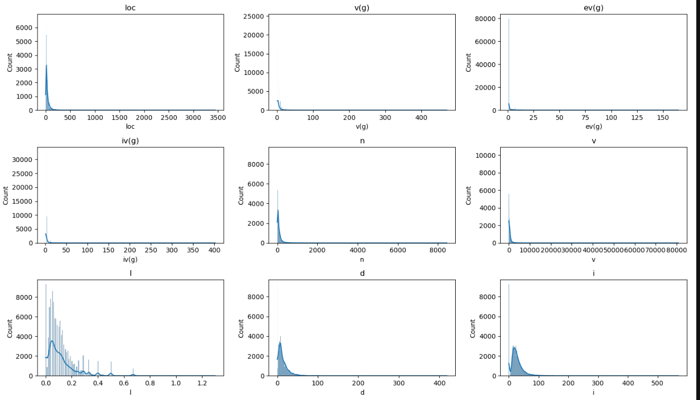
Experimental Setup
Pre-processing – Distribution plot

Slide 8
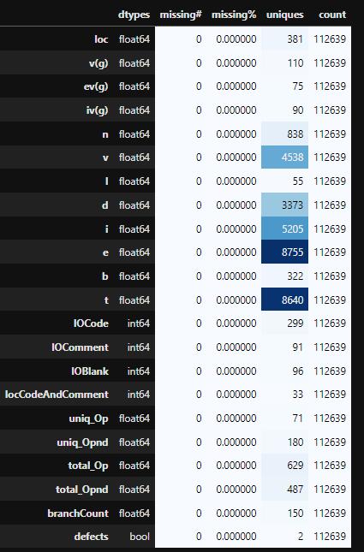
Statistics related to SDP DATASET
Check for the missing values in the dataset created.

Slide 9
Research Question
RQ1 : How effective is LGBM-SMOTENN to the SVM (base classifier) with no oversampling , no oversampling but boosting and SMOTEEN with SVM?
RQ2 : How effective is our proposed LGBM-SMOTENN to Cost Sensitive learning ?
RQ3 : How effective is our proposed LGBM-SMOTEEN to the over-sampling method (SMOTE) based boosting method and SMOTE based SVM model ?

Slide 10
Metrics for Imbalance classification
ACCURACY*
MCC
G-MEAN
AUC-ROC CURVE

Slide 11
RESULTS
RQ1 : How effective is LGBM-SMOTENN to the SVM(base classifier) with no oversampling , no oversampling but boosting and SMOTEEN with SVM?
Note : * represent the methods without oversampling.
Figure : Comparison of SMOTEEN+LGBM method to base classifier, boosting, SMOTEEN with SVM.
SMOTEEN+LGBM exceeds in terms of MCC, ROC-AUC and G-mean in comparison to SVM*, LGBM*, SMOTEEN with SVM.

Slide 12
RESULTS
RQ2 : How effective is our proposed LGBM-SMOTEEN to LGBM-CS ?
Figure : Comparison of the LGBM-Cost Sensitive learning to the SMOTEEN-LGBM model performance for SDP imbalance dataset.
SMOTEEN+LGBM based method performs better than LGBM-CS method which ensure that SMOTEEN+LGBM method can be a integrative approach to handle imbalance case in software defect prediction.

Slide 13
RESULTS
RQ3:How effective is our proposed LGBM-SMOTEEN to the Oversampling only (SMOTE based boosting method and SMOTE based SVM model) ?
Figure : Comparison of the SMOTE+SVM, SMOTE+LGBM and SMOTENN+LGBM for imbalance dataset in SDP.
SMOTENN+LGBM method performs better than the oversampling method, and oversampling with the boosting methods.

Slide 14
RESULTS
Comparison of proposed method in this study based on ROC-AUC for imbalanced dataset JM1.
Figure : Comparison of the SVM*, LGBM*, SMOTE+SVM, SMOTE+LGBM, LGBM-CS, SMOTEEN+SVM, SMOTEEN+LGBM for the imbalanced dataset JM1.
SMOTENN+LGBM method performs better than the oversampling method, and oversampling with the boosting methods.

Slide 15
CONCLUSION
Class imbalance is a problem to be overlooked in software defect prediction which impact the performance of the machine and deep learning models.
Integrative approach such as data + algorithmic data imbalance handling techniques can be a open avenue to look for software defect prediction.
SMOTEEN (Hybrid approach) accompanied by boosting (specially LGBM) can be a alternate approach(best) to handle the imbalance case with better performance.
Experimental result verifies that, SMOTEEN+Boosting can be a optimal approach better than SMOTEEN+SVM and SMOTE+SVM and imbalance cost sensitive learning too.
The main limitation of this studies include, exploration of SMOTEEN with other machine learning classifier such as RF, DT, KNN, and many other integrative approach such as Bagging, Stacking and deep learning models too.
Hyperparameters also impact the performance of the model which need focus in future work, but in this case all those parameters are set to default for fair comparisons.

Slide 16
REFRENCES
T. Wang and W. -h. Li, "Naive Bayes Software Defect Prediction Model," 2010 International Conference on Computational Intelligence and Software Engineering, Wuhan, China, 2010, pp. 1-4, doi: 10.1109/CISE.2010.5677057.
Hua Wei, Changzhen Hu, Shiyou Chen, Yuan Xue, Quanxin Zhang, Establishing a software defect prediction model via effective dimension reduction, Information Sciences, Volume 477,2019, Pages 399-409, ISSN 0020-0255, https://doi.org/10.1016/j.ins.2018.10.056.
Morasca, S., Lavazza, L. On the assessment of software defect prediction models via ROC curves. Empir Software Eng 25, 3977–4019 (2020). https://doi.org/10.1007/s10664-020-09861-4.
Wei Zheng, Tianren Shen, Xiang Chen, Peiran Deng, Interpretability application of the Just-in-Time software defect prediction model, Journal of Systems and Software,Volume 188, 2022, 111245, ISSN 0164-1212, https://doi.org/10.1016/j.jss.2022.111245.
Bejjanki KK, Gyani J, Gugulothu N. Class Imbalance Reduction (CIR): A Novel Approach to Software Defect Prediction in the Presence of Class Imbalance. Symmetry. 2020; 12(3):407. https://doi.org/10.3390/sym12030407.
Cagatay Catal, Banu Diri, Investigating the effect of dataset size, metrics sets, and feature selection techniques on software fault prediction problem, Information Sciences, Volume 179, Issue 8, 2009, Pages 1040-1058, ISSN 0020-0255, https://doi.org/10.1016/j.ins.2008.12.001.
Arora, I.; Tetarwal, V.; Saha, A. Open Issues in Software Defect Prediction. Proc. Comput. Sci. 2015, 46, 906–912.
Laradji, I.H.; Alshayeb, M.; Ghouti, L. Software defect prediction using ensemble learning on selected features. Inf. Softw. Technol. 2015, 58, 388–402.
Siers, M.J.; Islam, M.Z. Software defect prediction using a cost sensitive decision forest and voting, and a potential solution to the class imbalance problem. Inf. Syst. 2015, 51, 62–71.
Zhang, Z.W.; Jing, X.Y.; Wang, T.J. Label propagation based semi-supervised learning for software defect prediction. Autom. Softw. Eng. 2016, 24, 1–23.
S. Feng, J. Keung, X. Yu, Y. Xiao, and M. Zhang, “Investigation on the stability of SMOTE-based oversampling techniques in software defect prediction,” Inf Softw Technol, vol. 139, Nov. 2021, doi: 10.1016/j.infsof.2021.106662.
Q. Song, Y. Guo, and M. Shepperd, “A Comprehensive Investigation of the Role of Imbalanced Learning for Software Defect Prediction,” IEEE Transactions on Software Engineering, vol. 45, no. 12, pp. 1253–1269, Dec. 2019, doi: 10.1109/TSE.2018.2836442.
H. Ali, M. N. M. Salleh, R. Saedudin, K. Hussain, and M. F. Mushtaq, “Imbalance class problems in data mining: A review,” Indonesian Journal of Electrical Engineering and Computer Science, vol. 14, no. 3, pp. 1552–1563, Jun. 2019, doi: 10.11591/ijeecs.v14.i3.pp1552-1563.
H. Tong, B. Liu, and S. Wang, “Software defect prediction using stacked denoising autoencoders and two-stage ensemble learning,” Inf Softw Technol, vol. 96, pp. 94–111, Apr. 2018, doi: 10.1016/j.infsof.2017.11.008.
Y. Sun, M. S. Kamel, A. K. C. Wong, and Y. Wang, “Cost-sensitive boosting for classification of imbalanced data,” Pattern Recognit, vol. 40, no. 12, pp. 3358–3378, Dec. 2007, doi: 10.1016/j.patcog.2007.04.009.

Slide 17
Thank You
Q & A

